Slide 1
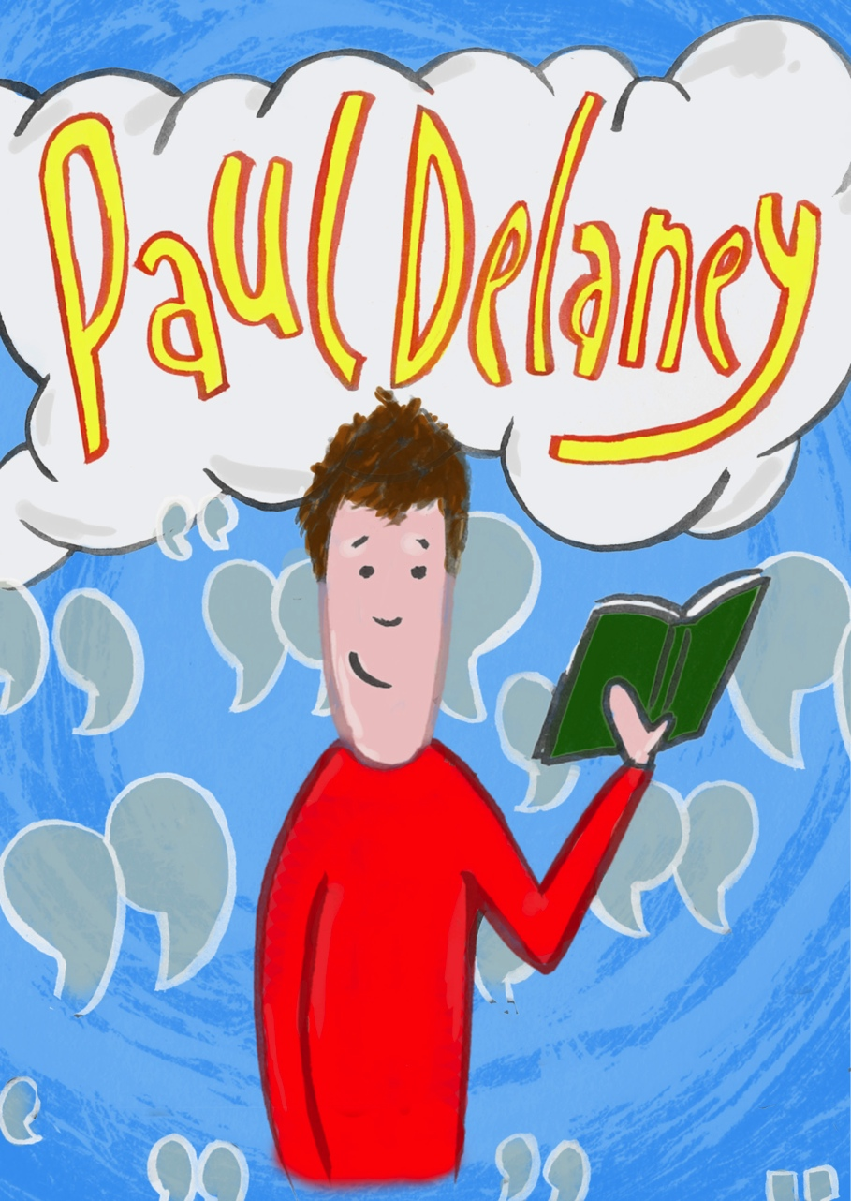

Slide 2
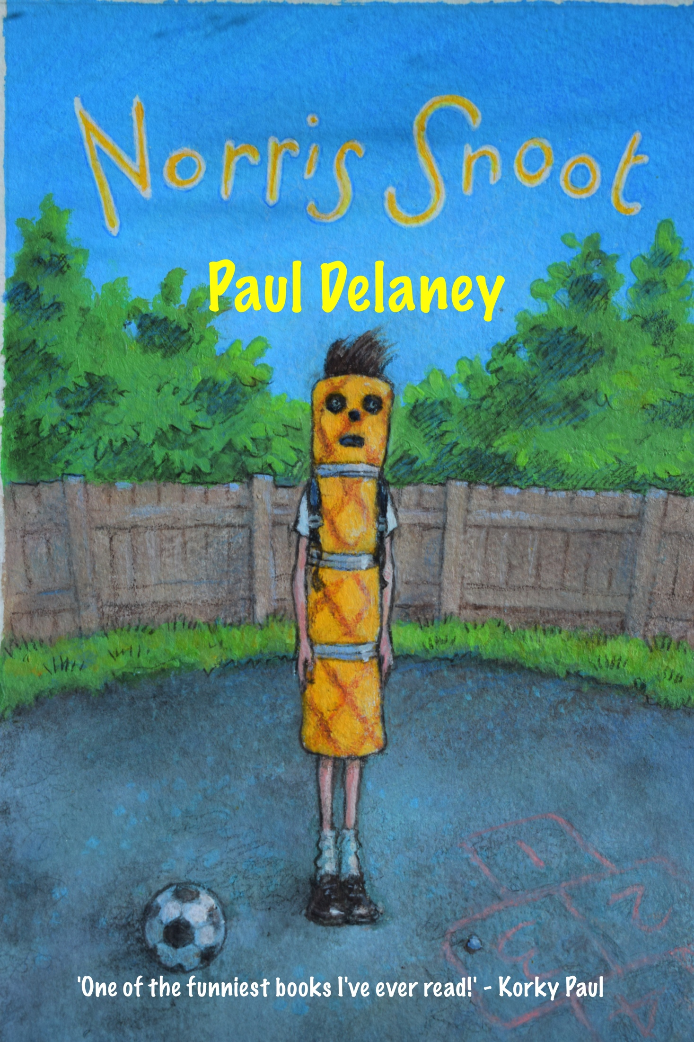

Slide 3
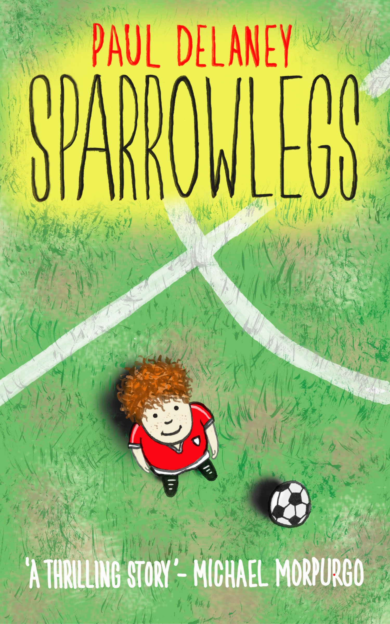

Slide 5
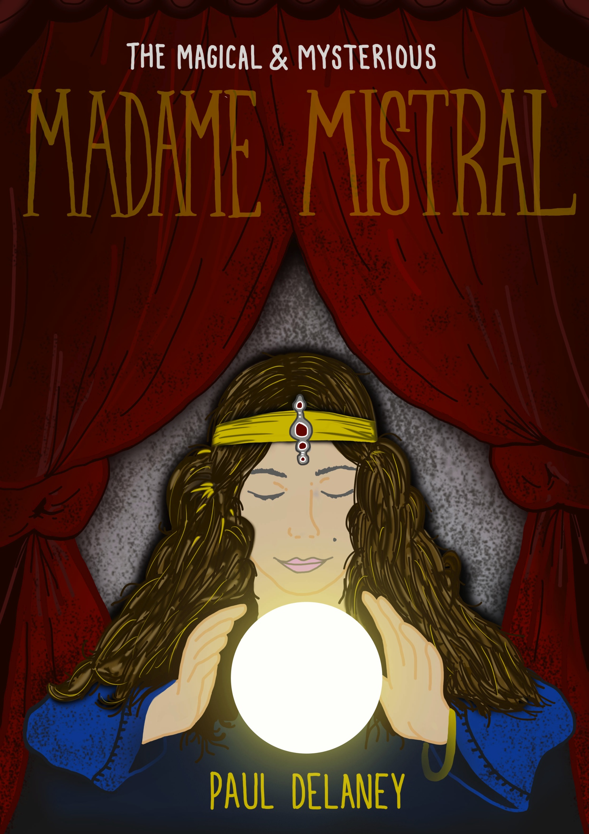

Slide 6
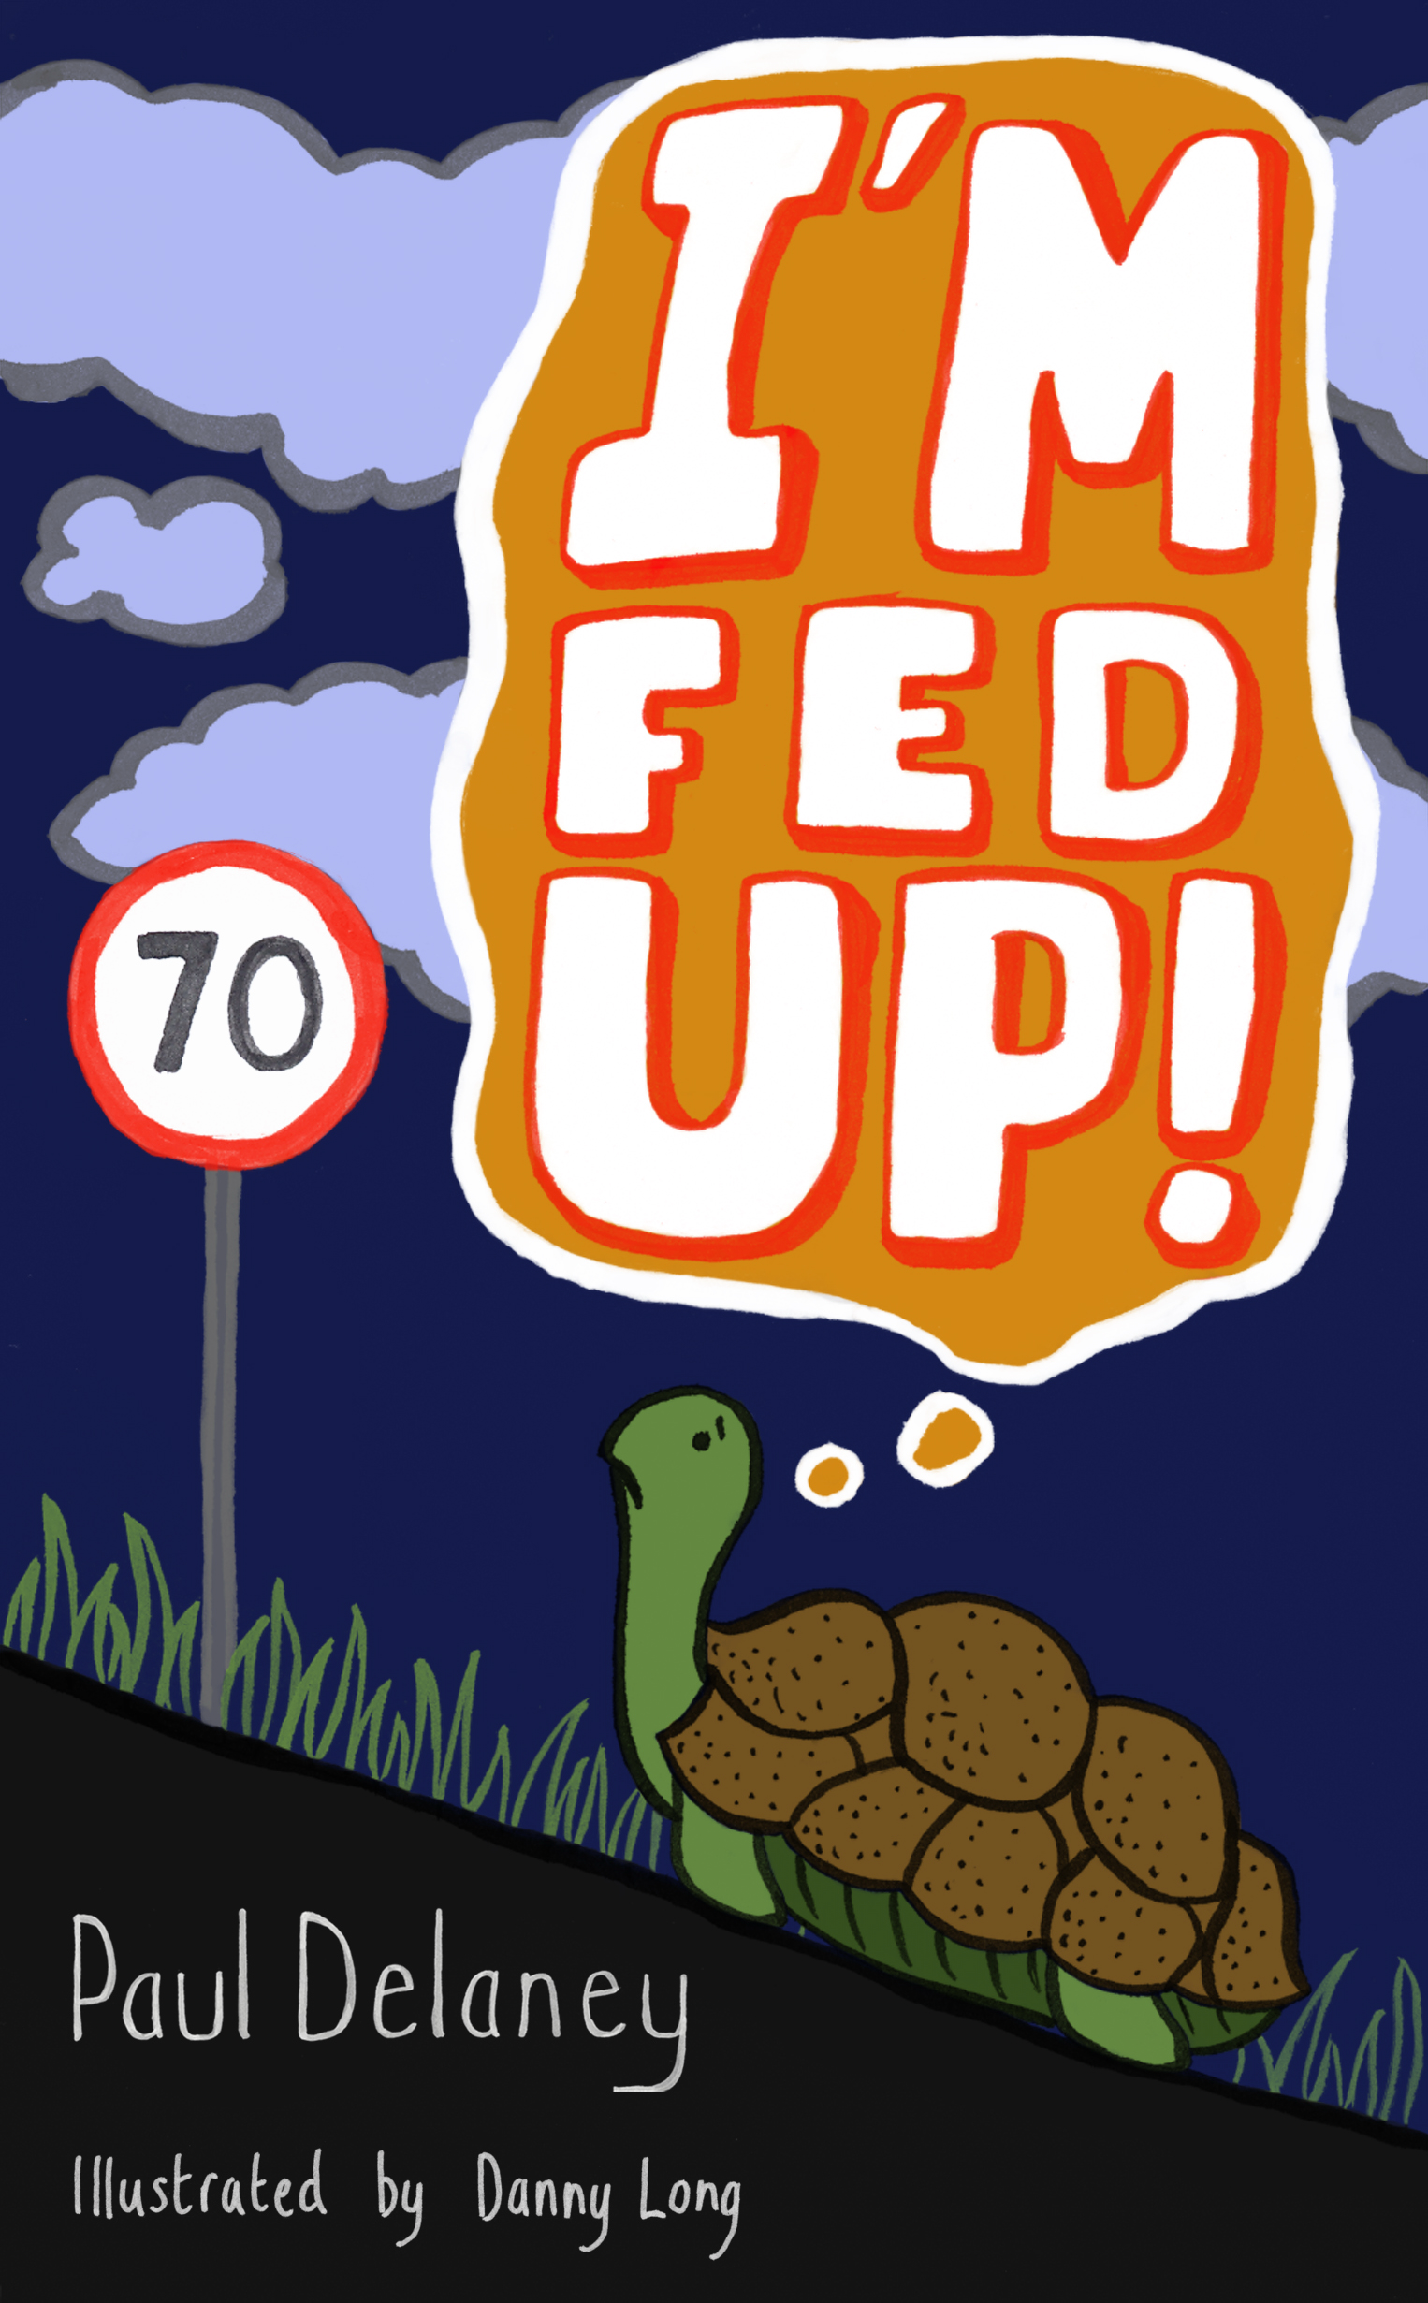

Slide 8
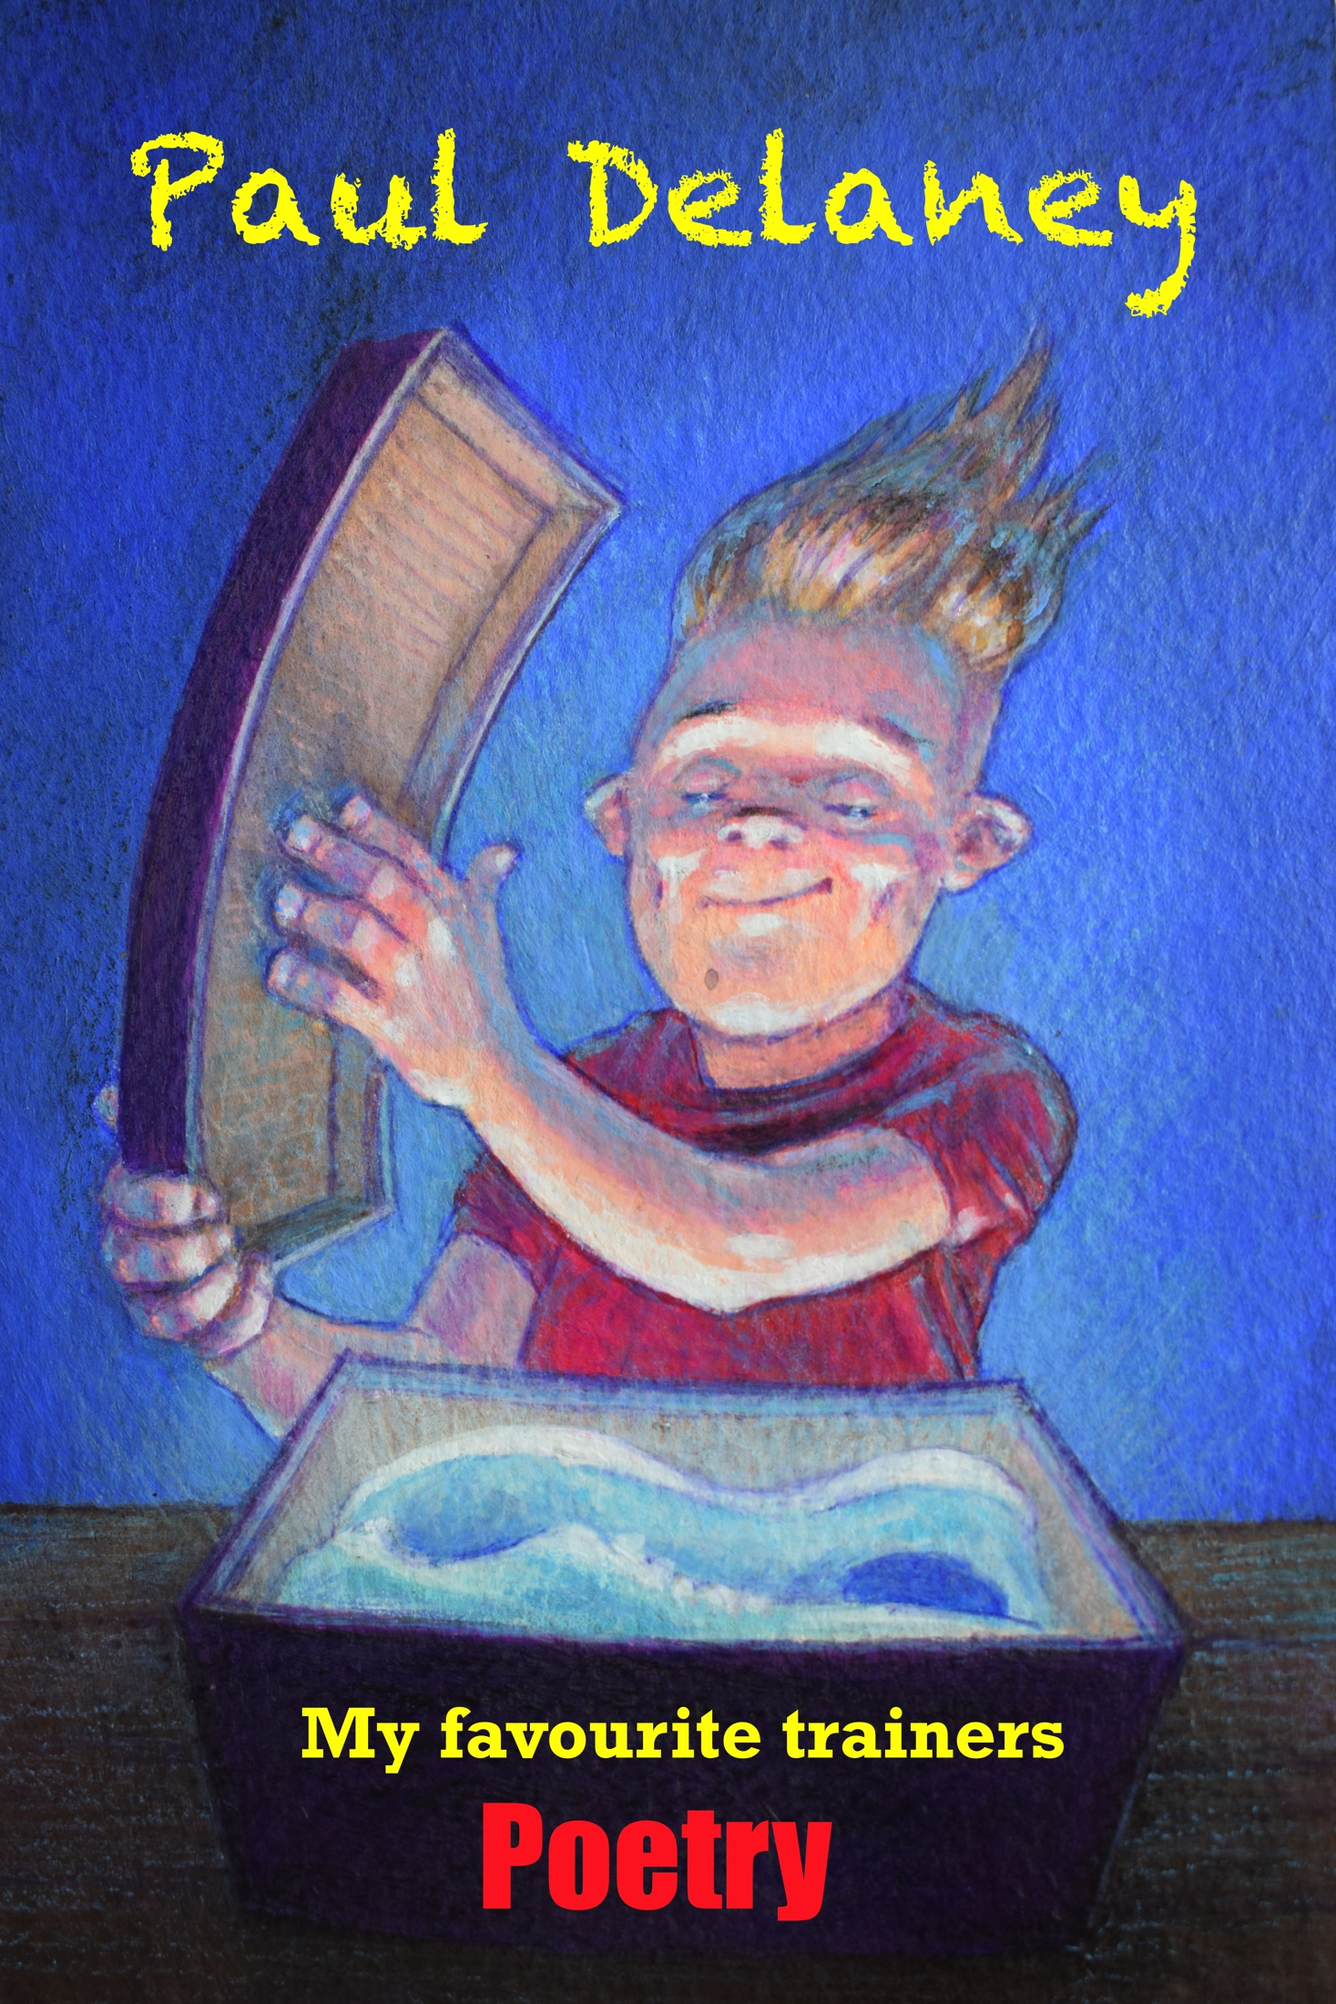

Slide 9
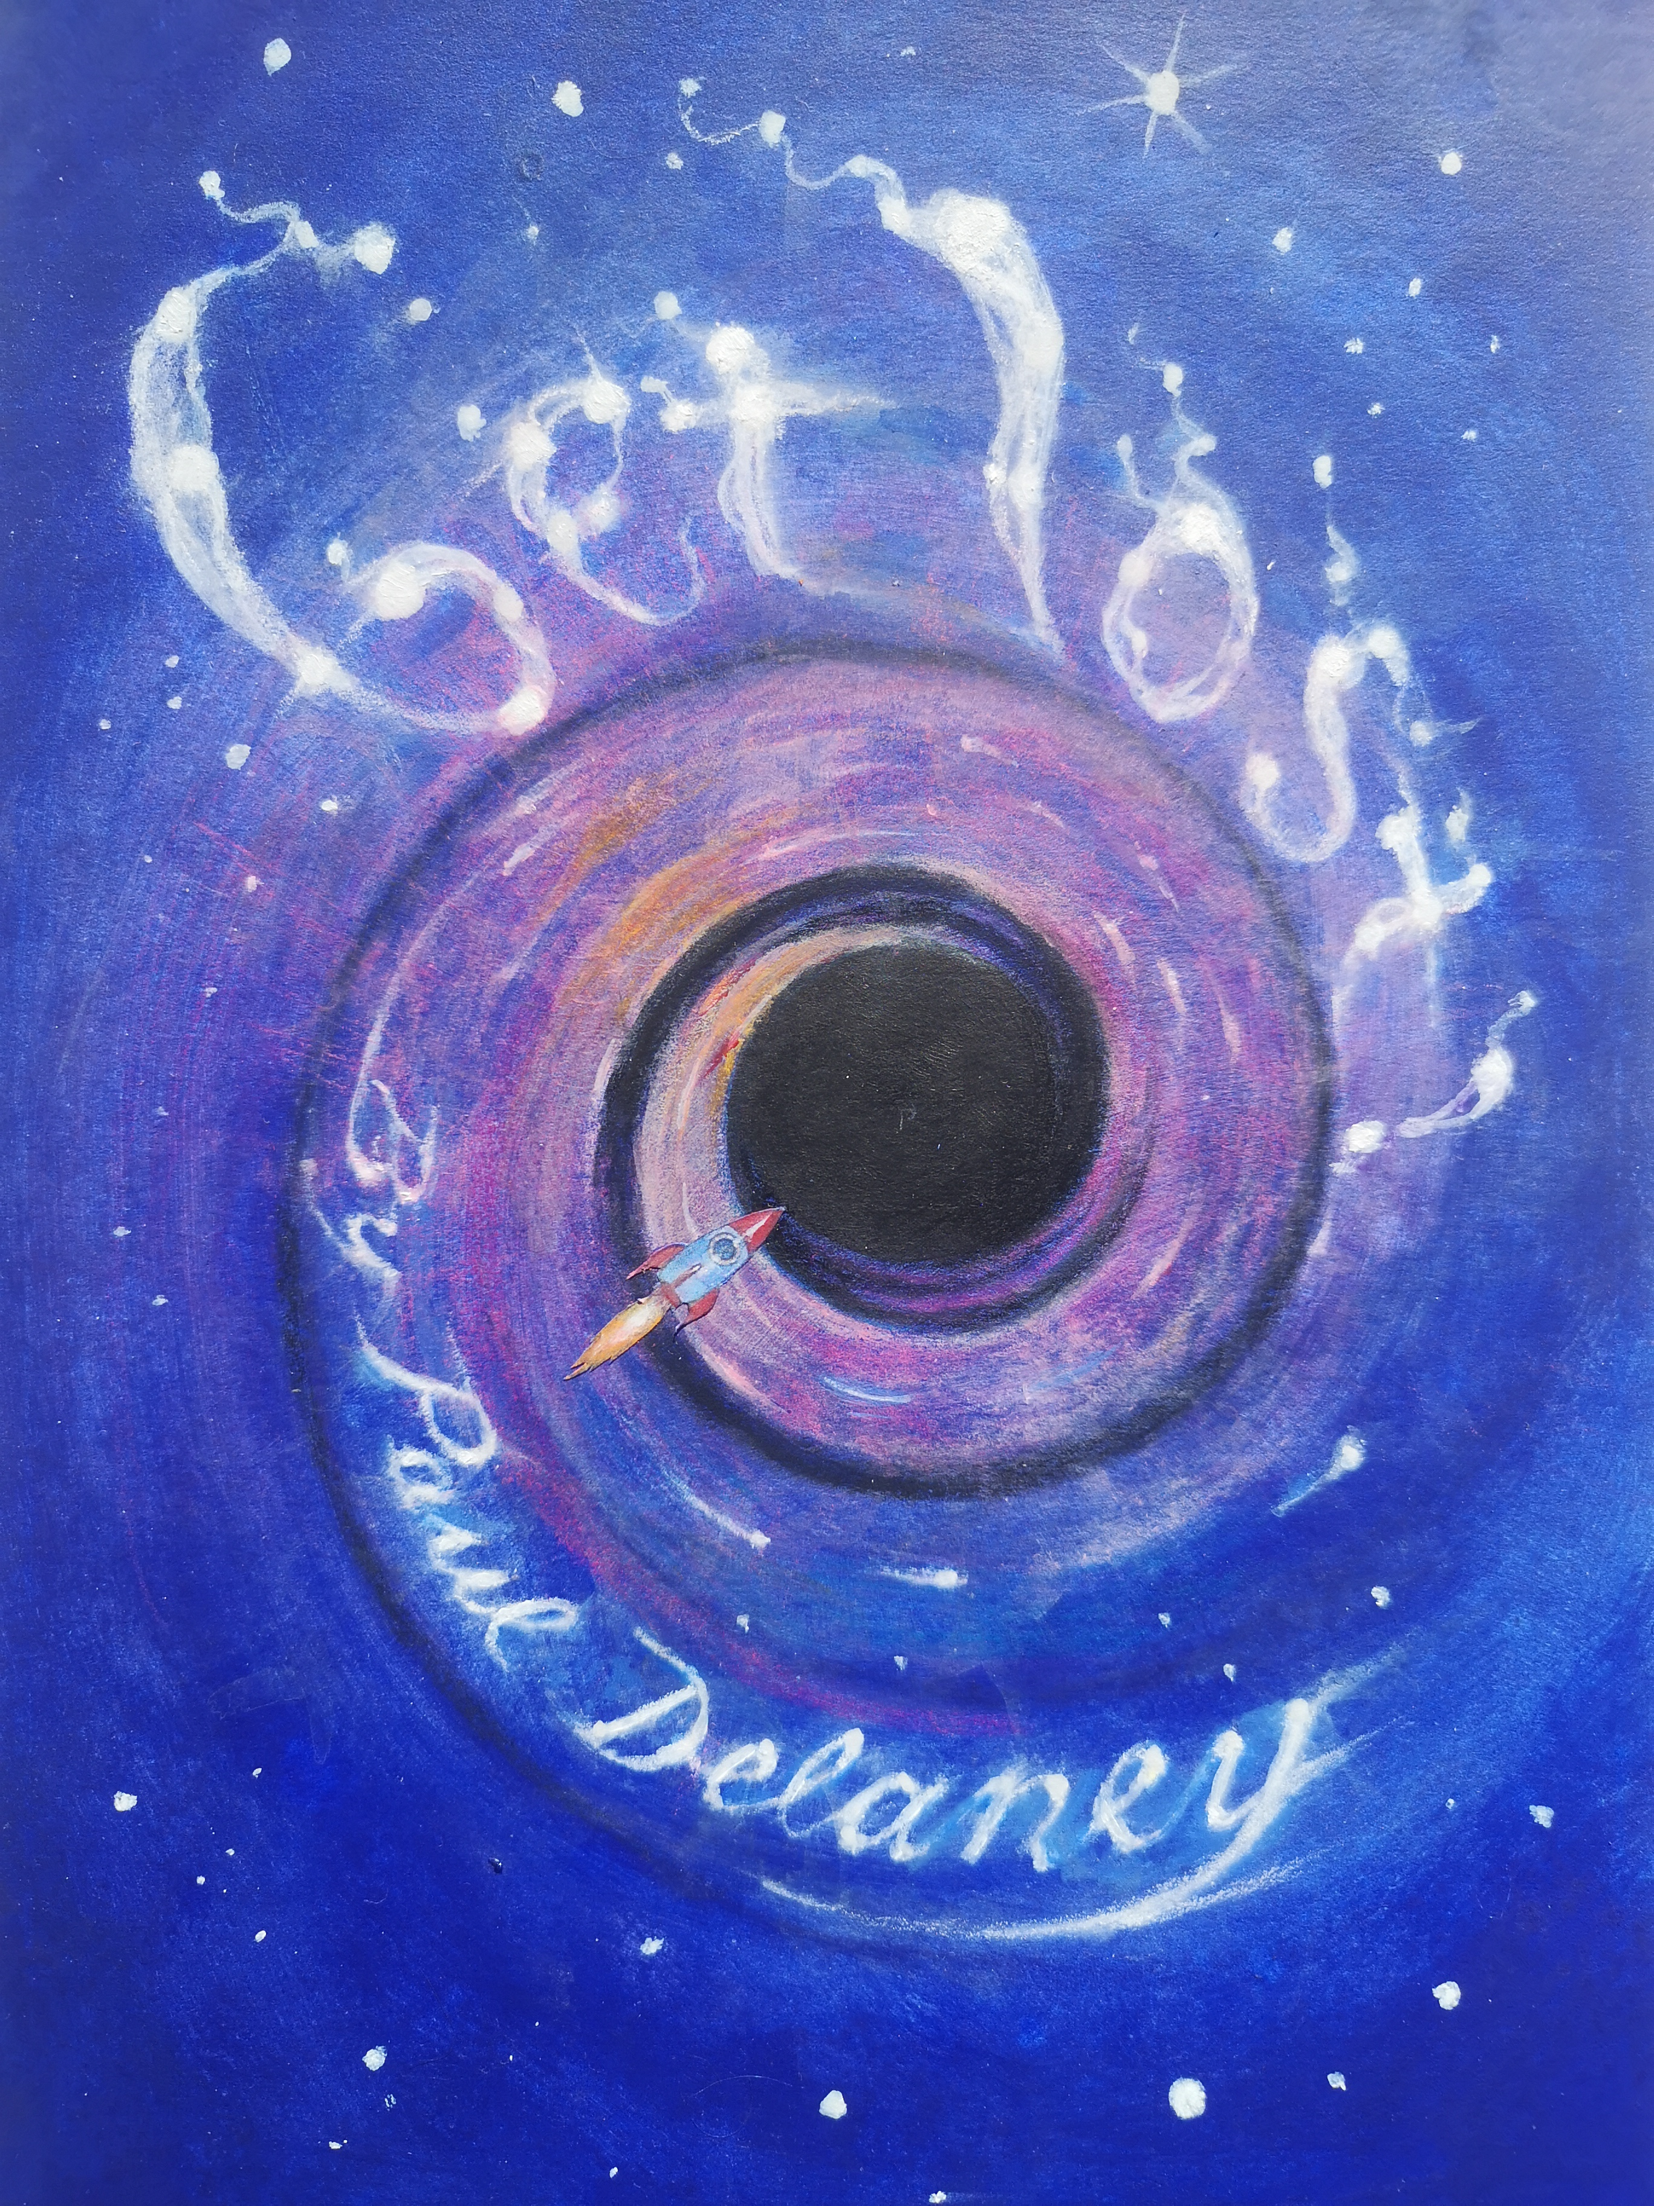

Slide 10
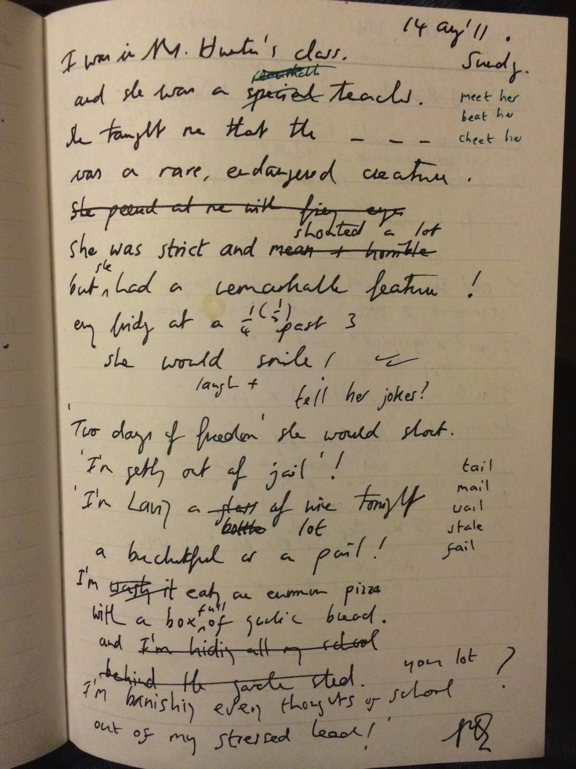

Slide 11
Mrs Hunter
I was in Mrs Hunter’s class
and she was a special teacher.
She taught me that the Komodo dragon
was a rare, endangered creature.
She was quick at mental maths
and nobody could beat her.
‘She’s a witch!’ my daddy said
when he got the chance to meet her.
She was strict and screamed and shouted
but had a remarkable feature:
Every Friday at a quarter past three,
she would
smile!

Slide 12
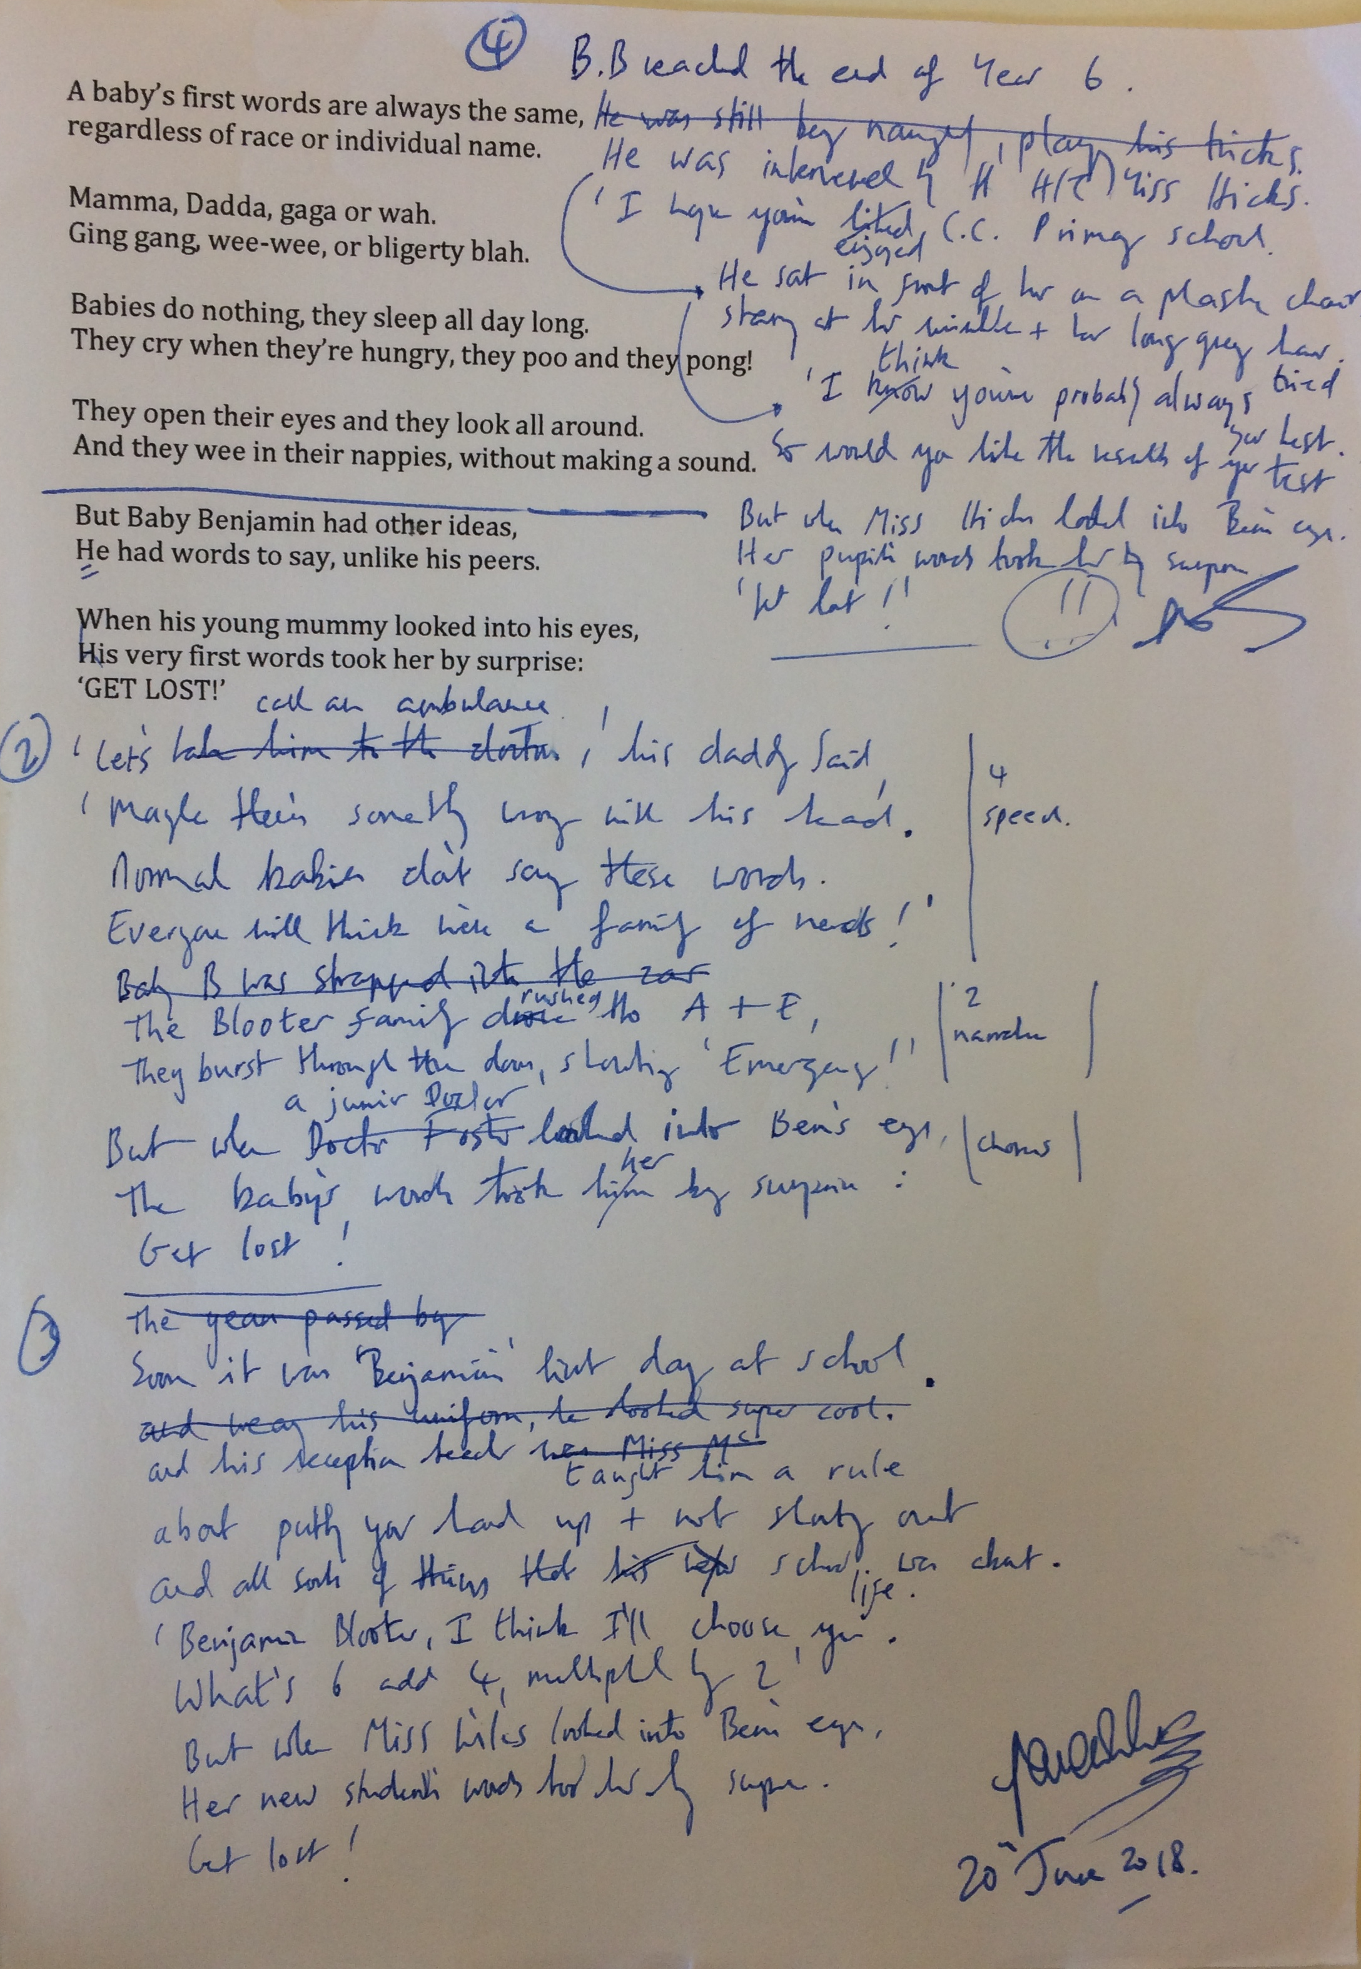

Slide 13
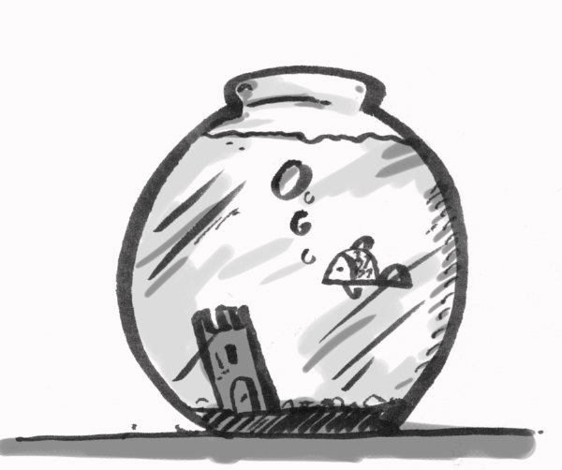
I wonder…
I wonder what a goldfish thinks about,
swimming in a bowl.
Is he dreaming of a bigger tank
or a long lost family shoal?
Is he waiting for another fish
to share his watery home?
Or is he happy all alone,
King of his own glass dome?
I wonder…

Slide 14
I wonder what a parrot thinks about,
sitting in a cage.
Is she happy talking and squawking,
a performer on a stage.
Is she dreaming of her jungle,
longing to stretch her wings?
Or is her spirit fading,
forgetting what freedom brings.
I wonder…

Slide 15
I wonder what a brown bear thinks about, dancing in the street.
Is he happy on his chain,
skipping to the beat?
Is he dreaming of a mountain,
a forest or a meadow?
Or praying for a future
and a better tomorrow?
I wonder…

Slide 16
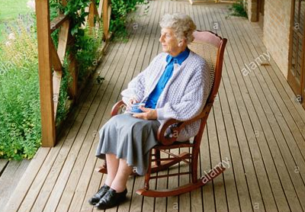
I wonder what an old lady thinks about,
sitting in her chair.
Is she happy in her home,
smiling with a stare?
Is she recalling her husband,
their perfect wedding day?
Or remembering her friends,
who’ve sadly passed away.
I wonder…

Slide 17
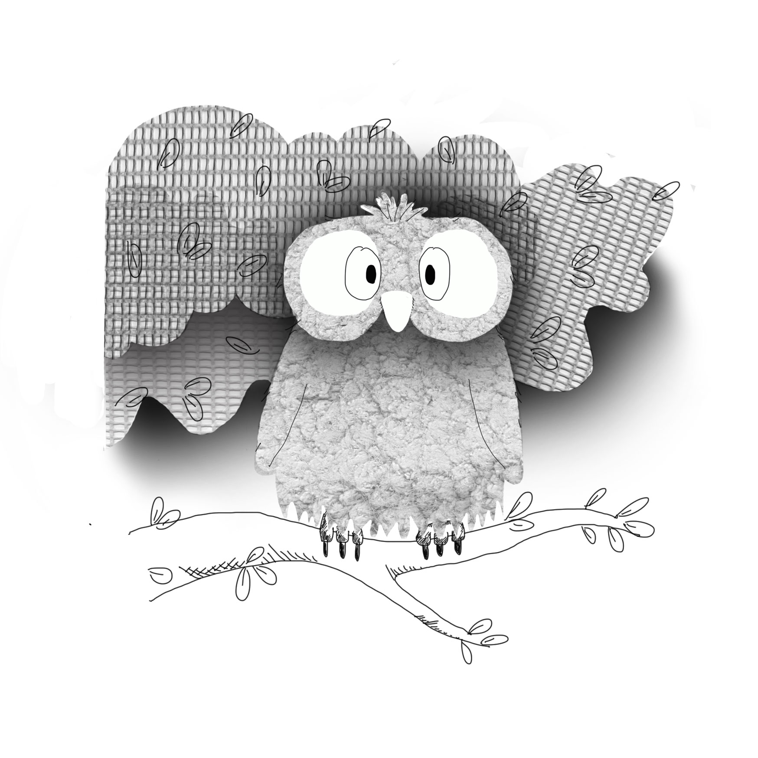

Slide 18
Cows go moo!
Cows go moo!
Sheep go baa!
Dogs shove their heads out of people’s cars.
Pigs go oink!
Hens go cluck!
Cats climb trees but often get stuck!
Birds go tweet!
Owls go hoot!
Hamsters store nuts and are rather cute.
Mums go ‘NO!’
Dads go ‘Ask your mum!’
And bees say nothing; They simply hum.

